Slide 1
Marketplace Revenue Leakage
& Gap Analysis using SQL
Complete Project Documentation
6
22K
1,387
15
5
Tables
Orders
Products
Tasks
Categories
Domain: E-Commerce Analytics | Tool: MySQL | Skills: DDL · DML · Joins · CTEs · Window Functions

Slide 2
Project Overview
Problem Statement, Goals & Business Context
Problem Statement
Modern marketplaces show healthy sales but declining profits — hidden factors like excessive discounts, high returns, logistics costs and payment fees silently erode margins.
Revenue Leakage
Product Profitability
Operational Cost
Identify losses from discounts, returns, logistics & fees
Which products/categories profit vs lose
Logistics & reverse logistics margin impact
Discount Effectiveness
Payment Impact
Strategic Support
Do discounts actually improve profitability?
Hidden cost of each payment gateway
Optimize pricing, promotions & operations
Marketplace Revenue Leakage & Gap Analysis | SQL Project

Slide 3
Database Design — 6 Tables
Relational Schema with PK, FK, Constraints & ER Relationships
products
1,800 rows
orders
22,000 rows
discounts
9,000 rows
product_id(PK), category, brand, supplier_id, cost_price, mrp, weight_kg, launch_date
order_id(PK), product_id(FK), customer_id, quantity, selling_price, payment_method, order_status, order_channel
discount_id(PK), order_id(FK-UNIQUE), discount_amount, discount_type, coupon_code, is_stackable
returns
4,000 rows
logistics_cost
13,000 rows
payment_fees
6 rows
return_id(PK), order_id(FK-UNIQUE), return_reason, refund_mode, refund_status, customer_fault_flag
logistics_id(PK), order_id(FK-UNIQUE), shipping_cost, reverse_shipping_cost, delivery_days, delivery_status
payment_method(PK), fee_percentage, settlement_days — Lookup table for gateway fee rates
ER: products(1)→orders(N)→discounts/returns/logistics_cost(1:0..1) | payment_fees(1)→orders(N)
Marketplace Revenue Leakage & Gap Analysis | SQL Project

Slide 4
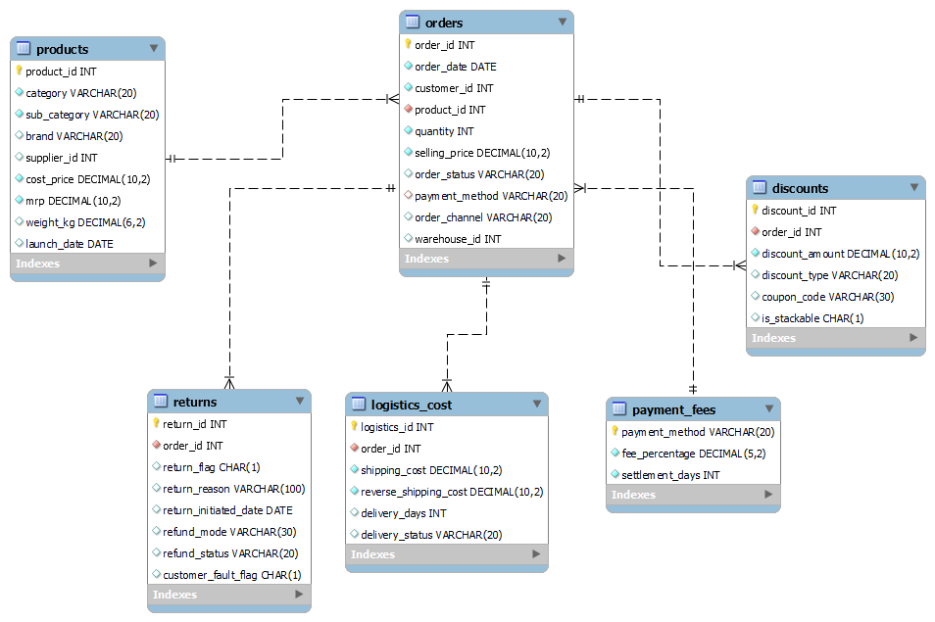
ER diagram

Slide 5
Data Cleaning & Quality Fixes
Issues Found & Fixed Across All 6 Tables — Before Analysis
Table | Issue | Count | Fix Applied
products | cost_price ≤ 0 OR mrp < cost_price | 369 | Deleted + FK cascade (FOREIGN_KEY_CHECKS=0)
products | NULL category / brand / weight_kg | 658 | Filled via supplier_id, category avg
orders | NULL order_status / order_channel | 9,940 | Filled with most frequent value
orders | payment_method = INVALID | 4,471 | Replaced with WALLET (mode value)
orders | quantity = 0 OR selling_price = 0 | 831 | Deleted + child records removed
discounts | NULL discount_type / coupon / stackable | 7,062 | Filled with mode values
logistics | shipping_cost < 0 / NULL delivery fields | 3,913 | Avg replacement & mode fill
payment_fees | NULL settlement_days (PAYLATER) | 1 | Filled with average (2 days)
After Cleaning: 15,766 valid orders | 1,387 products | Zero NULL values in key columns | Base view vw_order_summary created
Marketplace Revenue Leakage & Gap Analysis | SQL Project

Slide 6
Task 1: Revenue vs Profit Reality
vw_order_summary — Base View Powering All 15 Tasks
15,766
₹4,99,32,433
₹1,48,37,233
29.71%
Total Orders
Gross Revenue
Net Profit
Profit Margin
Component | Amount | % Revenue
Gross Revenue | ₹4,99,32,433 | 100.00%
− Product Cost | ₹2,12,66,100 | 42.59%
− Return Losses | ₹88,09,572 | 17.64% ← #1 Leakage
− Discounts | ₹37,34,972 | 7.48% ← #2 Leakage
− Payment Fees | ₹10,97,002 | 2.20%
− Logistics Cost | ₹7,59,743 | 1.52%
= Net Profit | ₹1,48,37,233 | 29.71%
Marketplace Revenue Leakage & Gap Analysis | SQL Project

Slide 7
Tasks 2 & 3: Category Sales & Loss-Making Products
Category Profit Analysis + 276 Loss-Making Products Identified
1,387
1,111
276
₹13,73,976
Products Analyzed
Profitable (80.1%)
Loss-Making (19.9%)
Total Loss Amount
Category | Revenue | Margin% | Return%
Electronics | ₹1,34,75,887 | 29.09% | 18.16%
Fashion | ₹1,30,77,195 | 27.78% | 17.41%
Grocery | ₹79,97,456 | 31.48% | 17.88%
Beauty | ₹84,26,890 | 29.61% | 17.35%
Home | ₹69,55,005 | 32.66% ✓ | 17.10% ✓
Marketplace Revenue Leakage & Gap Analysis | SQL Project

Slide 8
Tasks 4 & 6: Discount Usage & Profit Gap
37.94% of Orders Discounted — But Discounts Reduce Profit by 41.30%
37.94%
₹37,34,972
₹624.47
-₹460.90
Orders Discounted
Total Discount
Avg Disc/Order
Profit Gap/Order
Order Type | Orders | Avg Discount | Avg Profit | Margin%
Non-Discounted | 9,785 | ₹0 | ₹1,115.94 | 35.30%
Discounted | 5,981 | ₹624.47 | ₹655.04 | 20.62%
Gap | — | — | -₹460.90 | -14.68%
Range | Orders | Avg Profit | Margin% | Verdict
₹1-₹200 | 2,403 | ₹1,055 | 33.23% | ✓ Profitable
₹201-₹400 | 3,164 | ₹930 | 29.44% | Acceptable
₹1,000+ | 414 | -₹3,772 | -113.85% | ✗ LOSS
Marketplace Revenue Leakage & Gap Analysis | SQL Project

Slide 9
Tasks 5 & 10: Payment Method Analysis & Fee Leakage
COD Pays 39.93% of All Fees — Shift to UPI Saves ₹2,87,829
UPI
CARD
WALLET
COD
Fee Rate:
1.2%
Fee Rate:
2.1%
Fee Rate:
2.0%
Fee Rate:
3.5%
Net Margin:
31.57%
Net Margin:
31.51%
Net Margin:
29.40%
Net Margin:
26.46%
Return Rate:
17.02%
Return Rate:
16.55%
Return Rate:
18.20%
Return Rate:
18.76%
Metric | COD | UPI | Saving
Fee Rate | 3.5% | 1.2% | -2.3%
Avg Fee/Order | ₹111.05 | ₹38.25 | ₹72.80
Total Fees Paid | ₹4,37,998 | ₹1,50,169 | ₹2,87,829
Profit Margin | 26.46% | 31.57% | +5.11%
Return Rate | 18.76% | 17.02% | -1.74%
Marketplace Revenue Leakage & Gap Analysis | SQL Project

Slide 10
Tasks 7 & 8: Return Impact & Reason Analysis
Returns are #1 Leakage — ₹40,07,357 Total Loss | 17.64% Return Rate
2,781
17.64%
₹88,09,572
₹1,441
Returned Orders
Return Rate
Revenue Reversed
Avg Loss/Return
Return Reason | Returns | Rev Lost | Loss | Avg Loss | Fix Needed
Damaged | 455 | ₹14,31,732 | ₹7,18,676 | ₹1,579 | Better packaging
Not Specified | 488 | ₹14,90,657 | ₹6,78,539 | ₹1,390 | Make mandatory
Quality Issue | 470 | ₹15,28,729 | ₹6,61,049 | ₹1,406 | QC checks
Customer Changed Mind | 477 | ₹14,92,465 | ₹6,52,297 | ₹1,368 | Better content
Late Delivery | 435 | ₹14,44,816 | ₹6,50,520 | ₹1,495 | Realistic ETA
Wrong Item | 456 | ₹14,21,173 | ₹6,46,276 | ₹1,417 | Barcode scan
If return rate → 10%: saves 1,205 returns → +₹17,36,377 profit (+3.48% margin) | Reduce → 8%: saves 1,520 returns → +₹21,90,285 profit (+4.39% margin)
Marketplace Revenue Leakage & Gap Analysis | SQL Project

Slide 11
Tasks 9 & 11: Logistics Burden & Complete Leakage Breakdown
Orders where Logistics > 20% of Value | Full Revenue Leakage Diagnosis
152
59.21%
-₹23,433
₹600
Burden Orders (0.96%)
Are Loss-Making
Total Burden Loss
Recommended Min Order Value
Complete Leakage Ranking
Rank | Source | Amount | % Revenue | Fix
#1 | Return Losses | ₹88,09,572 | 17.64% | Reduce return rate → 10%
#2 | Discounts | ₹37,34,972 | 7.48% | Cap max discount ₹400
#3 | Payment Fees | ₹10,97,002 | 2.20% | Shift COD to UPI
#4 | Logistics | ₹7,59,743 | 1.52% | Min order ₹600
Total | Leakage | ₹1,44,01,289 | 28.84% | All 4 sources
Marketplace Revenue Leakage & Gap Analysis | SQL Project

Slide 12
Task 12: Product Profit Ranking
Pareto: Top 32.7% Products = 80% of Profit | Star vs Worst Products
Top Products by Profit
Rank | ProdID | Cat | Profit | Margin% | Returns
#1 | 1568 | Electronics | ₹82,956 | 73.10% | 11.11%
#2 | 1302 | Fashion | ₹77,589 | 80.26% | 13.64%
#3 | 1113 | Fashion | ₹73,335 | 79.68% | 0.00% ✓
#13 | 610 | Electronics | ₹57,154 | 90.15% ✓ | 0.00% ✓
#15 | 815 | Electronics | ₹55,294 | 85.10% ✓ | 0.00% ✓
Worst Loss-Making Products
Rank | ProdID | Cat | Loss | Margin% | Return%
#1387 | 670 | Electronics | -₹27,985 | -40% | 76.47% ✗
#1386 | 1306 | Home | -₹23,206 | -46% | 25.00%
#1385 | 1565 | Home | -₹23,168 | -45% | 35.29%
#1384 | 1731 | Beauty | -₹21,984 | -68% | 5.88%
Marketplace Revenue Leakage & Gap Analysis | SQL Project

Slide 13
Task 13: Category Margin Stability
Standard Deviation of Margins — Returns & Discounts Drive Volatility
Category | Avg Margin | Std Dev | Neg Orders | Stability
Fashion | 19.67% | 82.48% | 23.71% | Most Volatile ✗
Grocery | 22.40% | 80.24% | 24.10% | High Volatility
Home | 25.29% | 79.06% | 23.35% | High Volatility
Beauty | 24.54% | 63.03% | 21.93% | Moderate ⚠
Electronics | 22.57% | 62.55% | 25.33% | Most Stable ✓
Margin Volatility Drivers (Correlation with Margin)
Factor | Correlation | Impact
Discounts | -0.54 | Strongest driver of volatility
Returns | -0.45 | Major driver of volatility
Order Value | +0.17 | Weak positive effect
Logistics | -0.02 | Negligible impact
Marketplace Revenue Leakage & Gap Analysis | SQL Project

Slide 14
Task 14: High-Risk Customer Analysis
1,326 Customers (19.33%) Cause -₹16,43,490 Losses | Market Avg: 17.64%
6,859
17.64%
1,326
-₹16,43,490
Total Customers
Market Avg Return Rate
HIGH RISK (19.33%)
HIGH RISK Total Loss
Segment | Customers | % | Avg Return% | Avg Profit/Cust | Total Profit
ZERO RETURNS | 4,988 | 72.72% | 0.00% | ₹2,990 | ₹1,49,15,556 ✓
NORMAL | 50 | 0.73% | 15.25% | ₹7,547 | ₹3,77,332 ✓
ABOVE AVERAGE | 495 | 7.22% | 29.17% | ₹2,400 | ₹11,87,836
HIGH RISK | 1,326 | 19.33% | 74.61% | -₹1,239 | -₹16,43,490 ✗
Top Loss-Causing Customers
Cust ID | Orders | Returns | Ret Rate | Total Loss
4494 | 16 | 12 | 75.00% | -₹24,112
4937 | 9 | 8 | 88.89% | -₹21,890
7363 | 7 | 7 | 100.00% | -₹12,928
Marketplace Revenue Leakage & Gap Analysis | SQL Project

Slide 15
Task 15: Executive Profitability Summary
Why is Profit Lower Than Expected? — Complete Consolidated Answer
Priority Action Plan
P1
Reduce return rate 17.64% to 10%
Gain: ₹44,04,786
P2
Cap max discount at ₹400
Gain: ₹14,93,989
P3
Remove 276 loss-making products
Gain: ₹13,73,976
Scenario | Net Profit | Margin%
Current State | ₹1,48,37,233 | 29.71%
Reduce Returns 50% | ₹1,92,42,019 | 38.54%
Cap Discounts 40% | ₹1,63,31,222 | 32.71%
Shift COD→UPI | ₹1,51,25,062 | 30.29%
Returns+Discounts Both | ₹2,07,36,008 | 41.53%
P4
Shift COD customers to UPI
Gain: ₹2,87,829
P5
Set min order value ₹600
Gain: ₹12,695
Marketplace Revenue Leakage & Gap Analysis | SQL Project

Slide 16
Key Findings & Strategic Recommendations
Top Findings
Priority Actions
Expected Impact
Net profit: ₹1,48,37,233 (29.71% margin)
P1: Reduce returns 17.64%→10%
Current profit margin: 29.71%
Returns = #1 leakage at 17.64% (₹88.1L)
Gain: +₹44,04,786 profit
After returns fix (50%): 38.54%
Discounts = #2 leakage at 7.48% (₹37.3L)
P2: Cap discounts max ₹400
After discounts cap: 32.71%
Home: best category (32.66% margin)
Gain: +₹14,93,989 profit
After BOTH fixed: 41.53%
UPI: best payment (31.57% margin, 1.2% fee)
P3: Remove 276 loss products
Recoverable profit: ₹58,98,775
Product 610: 90.15% margin, 0% returns
Save: ₹13,73,976 in losses
Growth: +39.75% profit increase
Product 670: -₹27,985 — remove immediately
P4: Shift COD → UPI payments
Best category to invest: Home
580 customers have 100% return rate
Save: ₹2,87,829 in fees
Best payment to promote: UPI
Marketplace Revenue Leakage & Gap Analysis | SQL Project | 15 Tasks | E-Commerce Analytics

